Slide 1
BIG DATA
WELCOME
TO

Slide 2
Databases
Relational Database
Non-Relational Database (NoSQL)
Flat File

Slide 3
Sqoop
Sqoop − “SQL to Hadoop and Hadoop to SQL”
Tool designed to transfer data between Hadoop and relational database servers such as MySQL, Oracle.
Import
Export
Sqoop Job

Slide 4
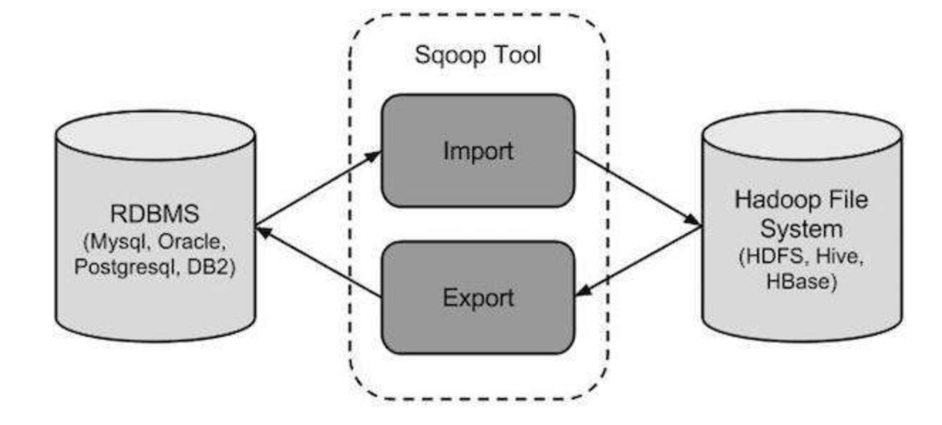
Sqoop work
Sqoop Import
Individual tables from RDBMS to HDFS
Each row in a table is treated as a record in HDFS
Stored as text data or as binary data in Avro and Sequence files
Sqoop Export
Set of files from HDFS to RDBMS
Sqoop records

Slide 5
Sqoop commands
Import
sqoop import --connect jdbc:mysql://localhost/db --username [mysql username] --table [table-name] --target-dir [hdfs directory]
Export
sqoop export --connect jdbc:mysql://localhost/db --username [mysql username] --table [table-name] --export-dir [source]
Sqoop Job
sqoop job --create myjob -- [type] -connect jdbc:mysql://localhost/db --username [mysql username] --table [table name]

